Slide 1
Applying Social Disorganization Theories to Chicago Crime Data
Module 3 Discussion Forum 2

Slide 2
Interpreting data from chicago
The following slide shows a map of neighborhoods from the city of Chicago.
Two kinds of data are displayed on the map:
Levels of homicide
Levels of collective efficacy

Slide 3
Map legend
There are two symbols to designate levels of homicide:
  + indicates a neighborhood with low homicide rates surrounded by other neighborhoods with low homicide rates
  * indicates a neighborhood with high homicide rates surrounded by other neighborhoods with high homicide rates

Slide 4
Map legend (continued)
The neighborhoods are shaded in 4 ways to show levels of collective efficacy. Each combination shows the level of collective efficacy in the neighborhood (high or low) and the levels of collective efficacy in surrounding neighborhoods (high or low).

Slide 5
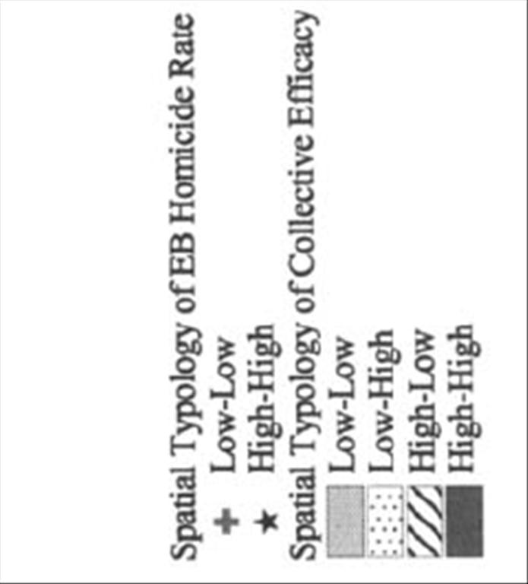
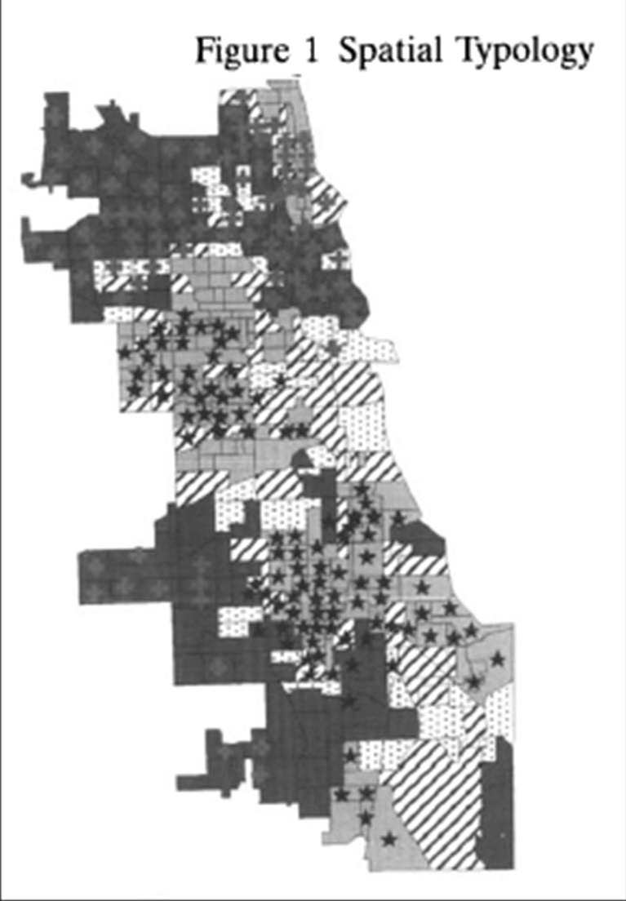
Chicago, IL 1996-1998

Slide 6
Discussion instructions
First, explain how Sampson, Raudenbush, and Earls would interpret this map.
Next, explain how another version of social disorganization theory might interpret the same homicide patterns and what additional information you would need to test that theory.
Are the two theories you discussed complementary or competing?

Slide 7
citation
This map was created for the following research article:
Morenoff, Jeffrey D., Robert J. Sampson, and Stephen Raudenbush. (2001). “Neighborhood Inequality, Collective Efficacy, and the Spatial Dynamics of Homicide.” Criminology 39(3): 517-560.

